Slide 1

Capstone 2
Anthony Ortega

Slide 2
Project Objectives: 1. Familiarize yourself with web application development and deployment workflows. 2. Enhance your understanding of version control systems (e.g., Git) for managing code changes. 3. Introduce containerization technologies (e.g., Docker) for application packaging.

Slide 3
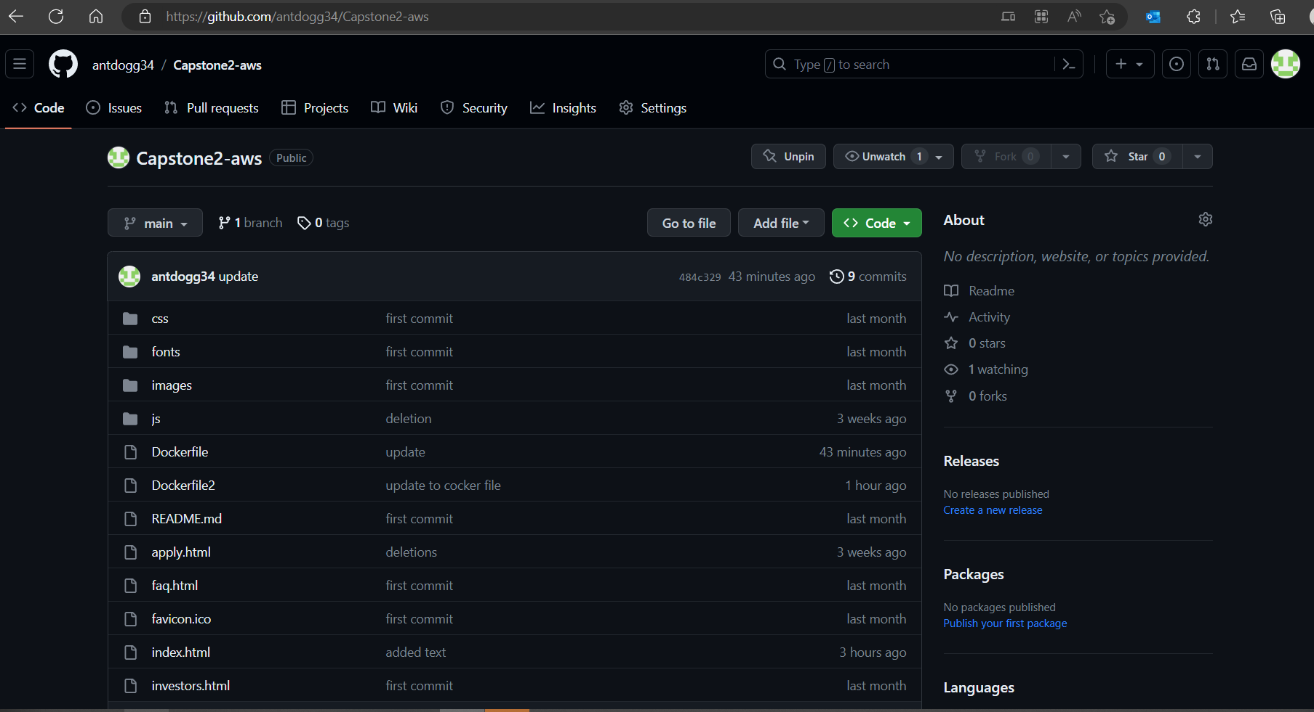
Created GitHub Repo: 1. Created A GitHub repository to ensure code versioning and a repo to push/pull from after updates to the .html file were completed.
https://github.com/antdogg34/Capstone2-aws

Slide 4
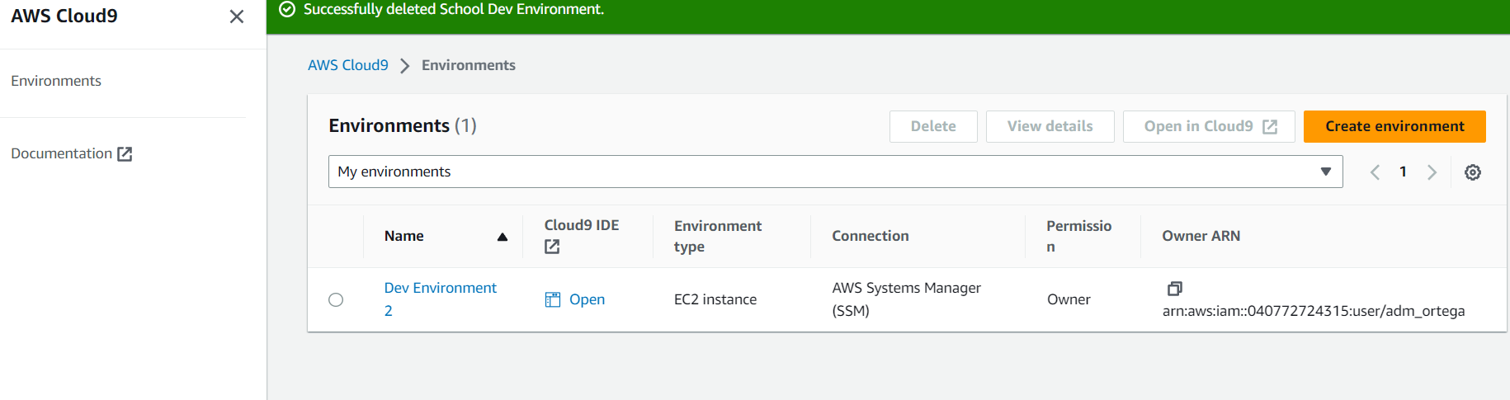
Created Cloud9 Service: 1. Created A Cloud9 instance for local repo and to be able to update the web app.

Slide 5
Installed Git/Docker on Cloud9 Service: 1. Installed git/docker on the Cloud9 instance Open AWS Cloud9: Go to the AWS Management Console (https://aws.amazon.com/console/). Sign in to your AWS account. Navigate to the AWS Cloud9 service. Create or Open a Cloud9 Environment: Create a new Cloud9 environment or open an existing one. Wait for the environment to be ready. Accessing the Terminal: Once the Cloud9 environment is ready, you'll see the IDE interface. At the bottom of the IDE, you'll find the terminal section. Verify Git Installation: To check if Git is installed, type the following command in the Cloud9 terminal: git --version

Slide 6
Installed Git/Docker on Cloud9 instance:
Accessing the Terminal:
Once the Cloud9 environment is ready, you'll see the IDE interface.
At the bottom of the IDE, you'll find the terminal section.
Install Docker (If Not Already Installed):
Run the following commands in the Cloud9 terminal to install Docker (only if it's not already installed):
sudo yum update -y
sudo yum install -y docker
sudo service docker start
Docker --version

Slide 7
Installed Git/Docker on Cloud9 Service: 1. Installed git/docker on the Cloud9 instance Open AWS Cloud9: Go to the AWS Management Console (https://aws.amazon.com/console/). Sign in to your AWS account. Navigate to the AWS Cloud9 service. Create or Open a Cloud9 Environment: Create a new Cloud9 environment or open an existing one. Wait for the environment to be ready. Accessing the Terminal: Once the Cloud9 environment is ready, you'll see the IDE interface. At the bottom of the IDE, you'll find the terminal section. Verify Git Installation: To check if Git is installed, type the following command in the Cloud9 terminal: git --version

Slide 8
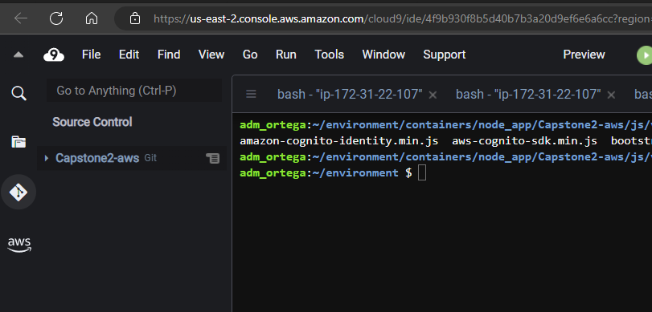
Cloned GitHub Repo to Cloud9 instance IDE: 1. Cloned from GitHub Repo: https://github.com/antdogg34/Capstone2-aws.git

Slide 9
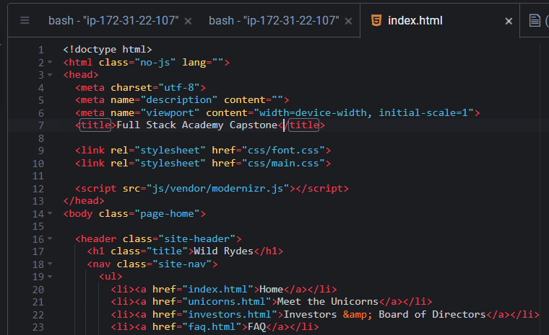
Updated the index.html file: 1. Update the Title Page: Full Stack Academy Capstone

Slide 10
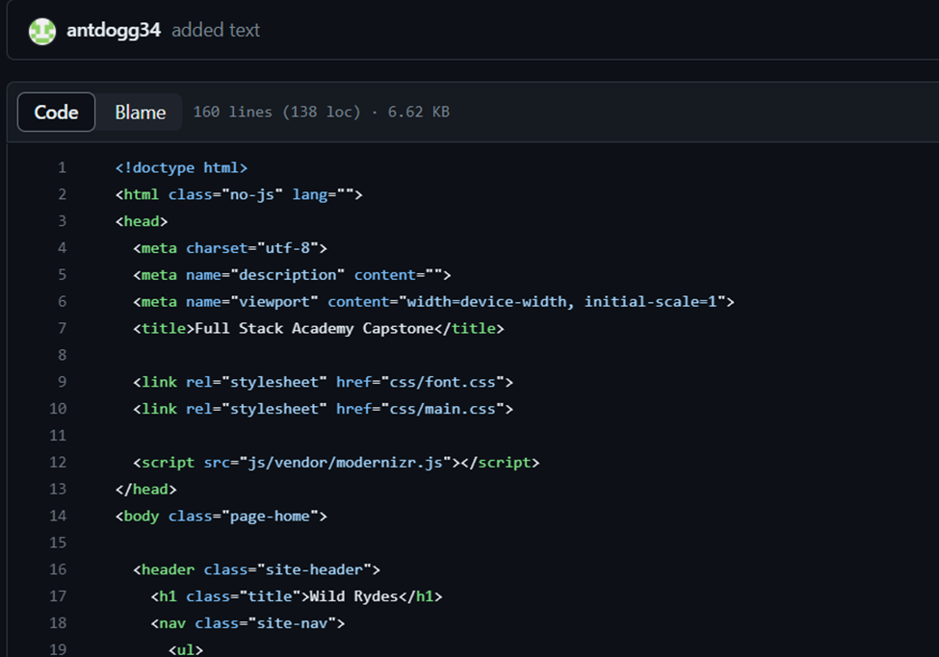
Push Update to GitHub: 1. Update to the Title Page: Ensure versioning/code changes Full Stack Academy Capstone

Slide 11
Created DockerFile and Moved the code to the correct directory: 1. Created the Dockerfile touch Dockerfile Updated the Dockerfile: FROM nginx RUN mkdir -p /usr/src/app WORKDIR /usr/src/app COPY . /usr/share/nginx/html EXPOSE 80:80 CMD ["nginx", "-g", "daemon off;"]

Slide 12
Created DockerFile and Moved the code to the correct directory: 1. Created the Dockerfile touch Dockerfile Updated the Dockerfile: FROM nginx RUN mkdir -p /usr/src/app WORKDIR /usr/src/app COPY . /usr/share/nginx/html EXPOSE 80:80 CMD ["nginx", "-g", "daemon off;"]

Slide 13
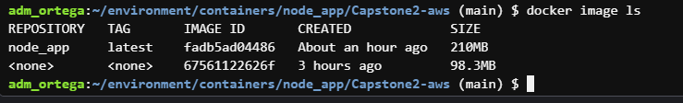
Created Container: 1. Created the Container image:

Slide 14
Created Container: 1. Created the Container:

Slide 15
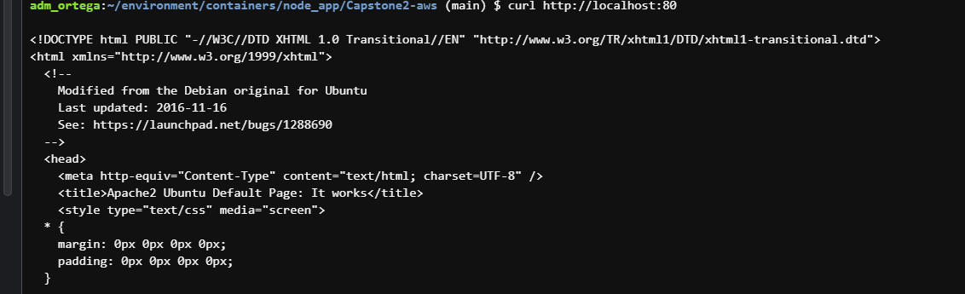
Created Container: 2. Curl command to verify:

Slide 16
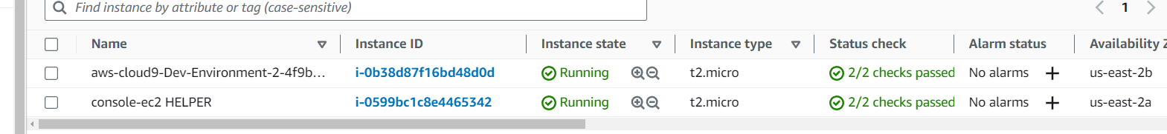
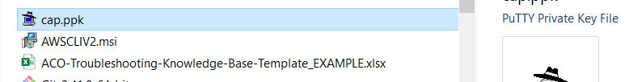
Created EC2 instance: 1. Created EC2 instance to run Container and PPK file for Putty session to access instance:

Slide 17
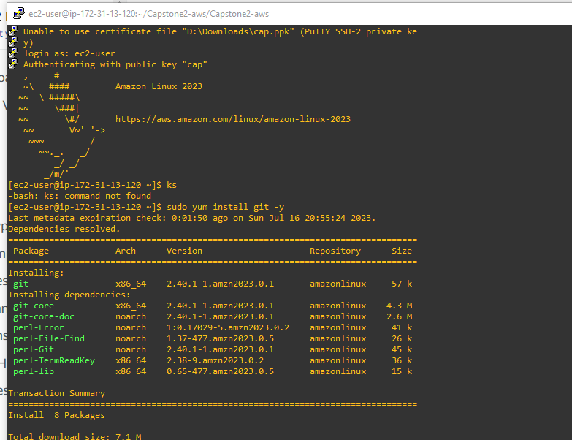
Updated and Installed docker and GIT on EC2 instance: sudo yum install git –y

Slide 18
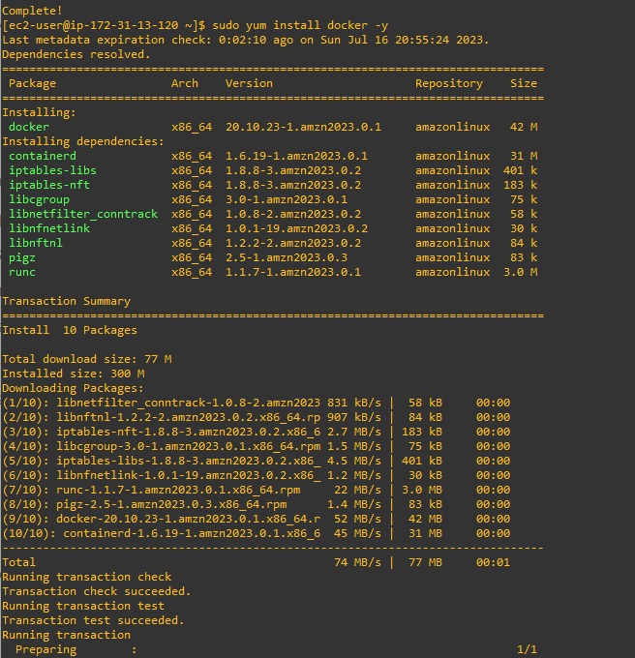
Updated and Installed docker and GIT on EC2 instance: sudo yum install docker –y

Slide 19
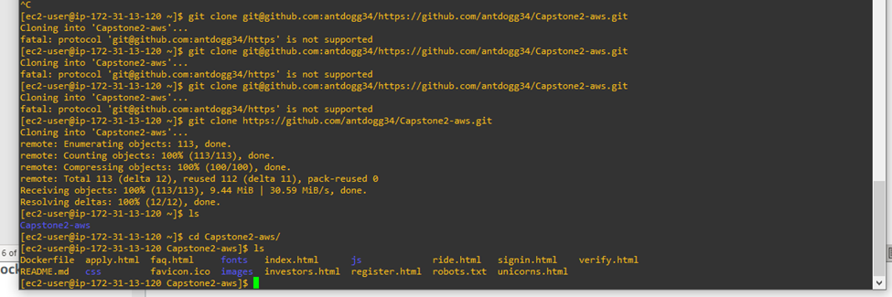
Cloned Repo from GitHub:

Slide 20
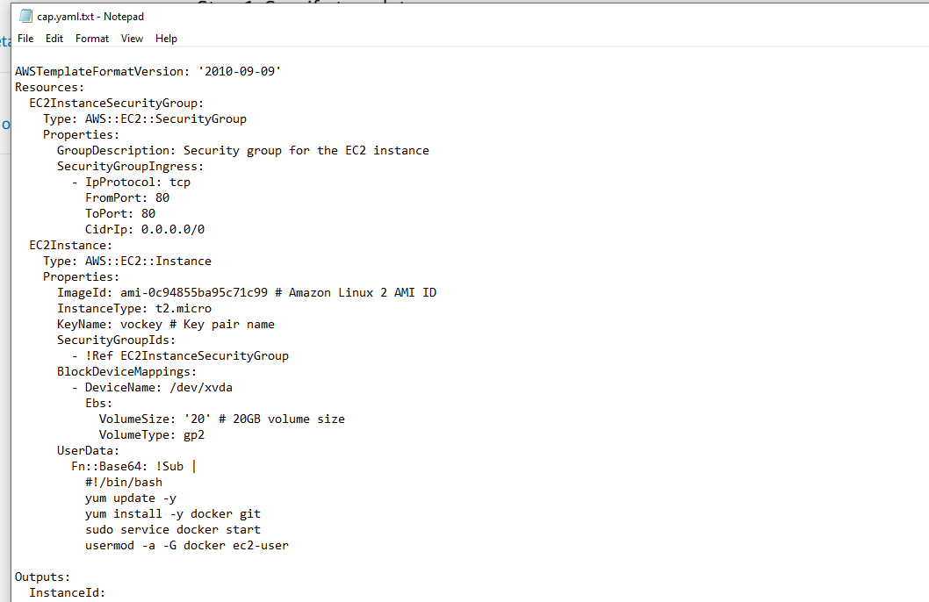
Created Yaml for CloudFormation script:

Slide 21
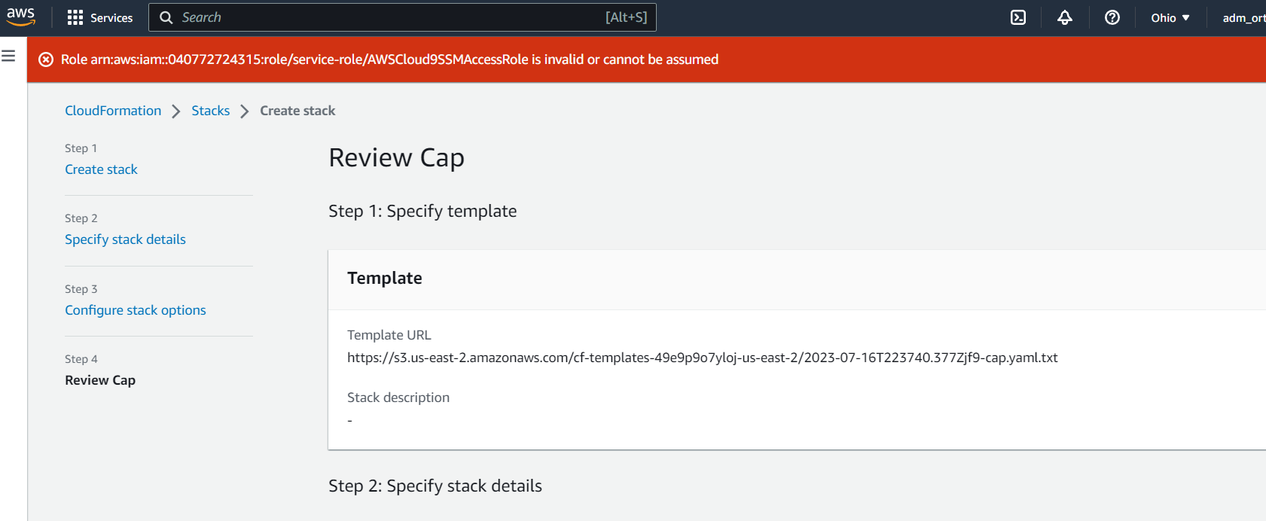
Tried to update the CloudFormation Role:

Slide 22

And I failed: Ran out of time.. Life!!!

Slide 23
Conclusion: Although I didn’t complete this project fully, this AWS Capstone project has provided me with a deep understanding of AWS services and their practical application in real-world scenarios. I developed valuable skills in cloud architecture, infrastructure automation, DevOps practices, and security considerations. Awesome Project!!!!

